Slide 1
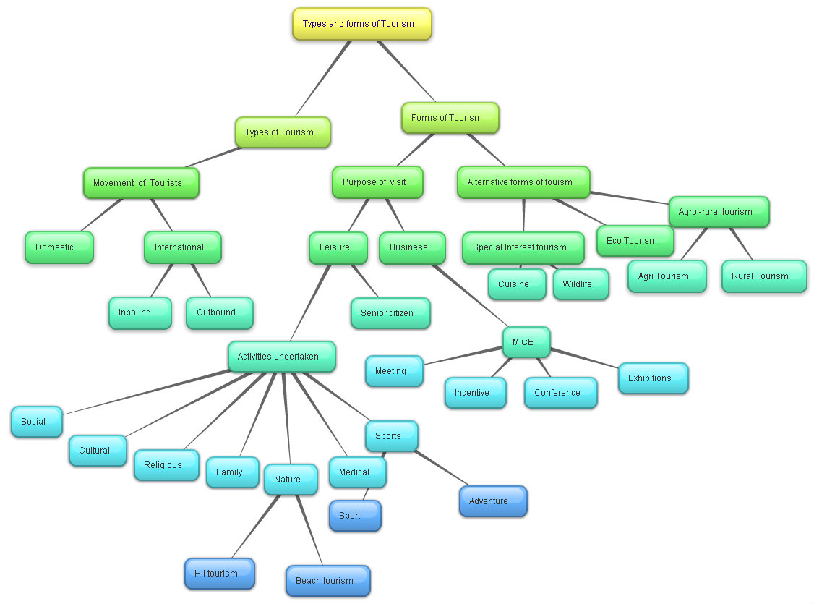
Types of Tourism

Slide 2
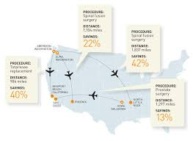
Types of Tourism
Movement of Tourist:
Domestic Tourism:
Domestic tourism is tourism involving residents of one country traveling only within that country.
A domestic holiday is a holiday (vacation) spent in the same country

Slide 3


International Tourism
International tourists are the number of tourists who travel to a country other than that in which they have their usual residence, but outside their usual environment, for a period not exceeding 12 months and whose main purpose in visiting is other than an activity remunerated from within

Slide 4
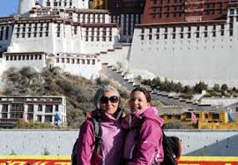
Inbound Tourist & Outbound Tourist:
Inbound tourism is when a non-resident or foreigner visits a given country,
outbound tourism is when a resident of a given country leaves that country to visit another one
Ex From an American perspective, if an American visits Germany, that is considered to be outbound tourism, but if a German visits the United States, that is considered to be inbound tourism.
If a country has more inbound than outbound tourism, it has a travel trade surplus, and a country with a travel trade surplus can consider tourism to be a very lucrative export

Slide 5
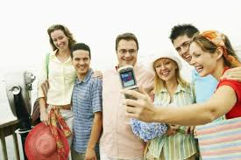

Activities undertaken
Social tourism “refers to programmes, events, and activities that enable all population groups – and particularly youth, families, retirees, individuals with modest incomes, and individuals with restricted physical capacity – to enjoy tourism, while also attending to the quality of relations between visitors and host .

Slide 6
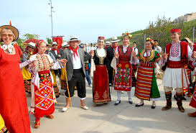
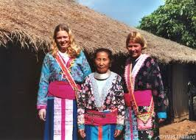
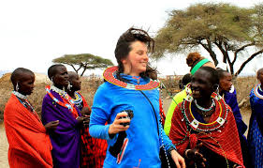
Cultural Tourism
Cultural tourism is concerned with a country or region's culture, specifically the lifestyle of the people in those geographical areas, the history of those people, their art, architecture, religion(s), and other elements that helped shape their way of life.

Slide 7
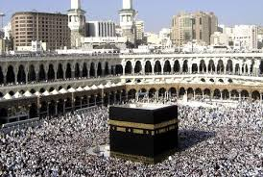
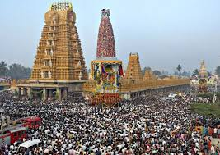
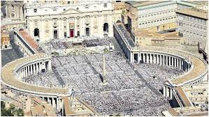
Religious Tourism
Religious tourism, also commonly referred to as faith tourism, is a type of tourism, where people travel individually or in groups for pilgrimage, missionary, or leisure (fellowship) purposes.

Slide 8
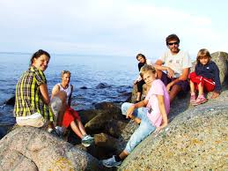
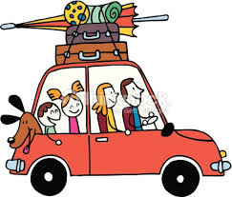

Family Tourism
Family tourism is a type of tourism where accommodation, meals, recreational activity and prices are specially adapted to suit the needs and comfort of families with children

Slide 9
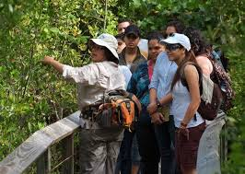
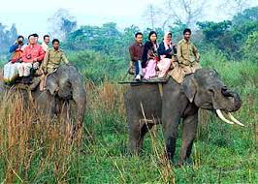

Nature Tourism
Nature tourism is the travel through and enjoyment of the natural world, carried out in a manner that promotes the protection of natural and human communities and consideration for those who will inherit our world.

Slide 10


Medical Tourism
Medical tourism or health tourism is the travel of people to another country for the purpose of obtaining medical treatment in that country
Some people travel to obtain medical surgeries or other treatments. Some people go abroad for dental tourism or fertility tourism

Slide 11

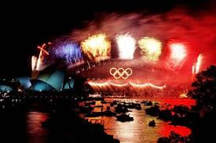

Sports tourism
Sport Tourism refers to travel which involves either observing or participating in a sporting event staying apart from their usual environment. Sport tourism is a fast-growing sector of the global travel industry

Slide 12


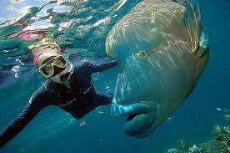
Adventure Tourism
Adventure tourism is a type of niche tourism involving exploration or travel to remote areas, where the traveler should expect the unexpected. Adventure tourism is rapidly growing in popularity as tourists seek unusual holidays, different from the typical vacation.

Slide 13



Leisure Tourism
When people are not working, studying or
sleeping they are free to make a choice
about what they do with their spare or
‘leisure’ time.

Slide 14

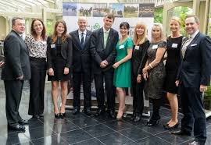
Business Tourism
Business tourism or business travel is a more limited and focused subset of regular tourism. During business tourism (traveling), individuals are still working and being paid, but are doing so away from both their workplace and home.

Slide 15
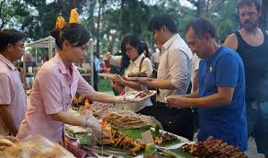
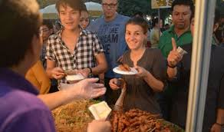
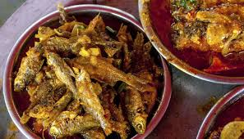
Cuisine Tourism
Culinary tourism or food tourism is the exploration of food as the purpose of tourism

Slide 16
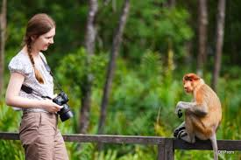
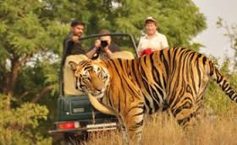
Wild life Tourism
Wildlife tourism can be an eco and animal friendly tourism, usually showing animals in their natural habitat. Wildlife tourism, in its simplest sense, is watching wild animals in their natural habitat.

Slide 17

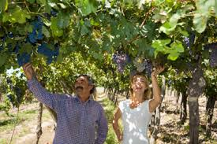
Agri Tourism
Agritourism or agrotourism, as it is defined most broadly, involves any agriculturally based operation or activity that brings visitors to a farm or ranch

Slide 18
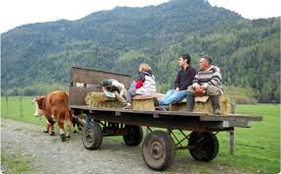
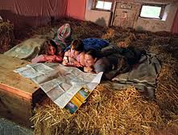
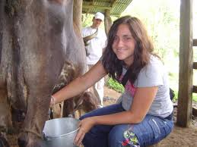
Rural Tourism
Rural tourism focuses on actively participating in a rural lifestyle. It can be a variant of ecotourism. Many rural villages can facilitate tourism because many villagers are hospitable and eager to welcome visitors.

Slide 19
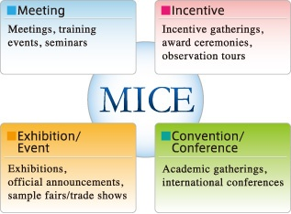
M I C E
Meetings, incentives, conferences, and exhibitions (MICE) is a type of tourism in which large groups, usually planned well in advance, are brought together for a particular purpose.

